Slide 1
Chapter 5 Induction and Recursion
Section 1
Mathematical Induction

Slide 2
Outline
Introduction
Mathematical Induction
Examples - Writing a Proof by Induction
Why Mathematical Induction is Valid

Slide 3
Introduction
Postage problem
  Assume that you live in the 1950’s, when postage for a first-class letter weighing 1 ounce or less cost 8¢.
  Heavier letters require more postage: an additional 1¢ for each extra ounce.
  You have a supply of 3¢ and 5¢ stamps.
Theorem.
  Using 3¢ and 5¢ stamps, you can put the correct postage on a letter of any weight.

Slide 4
Introduction
  Proof.
  Base case: A letter weighing ≤ 1 ounce requires 8¢ postage - One 3¢ and one 5¢ stamp.
  Extra 1: A letter weighing up to 1 ounce more than our base case (i.e., 2 ounces) requires 9¢ postage. We can replace the 5¢ stamp in the base case with two 3¢ stamps: 3¢ + 3¢ + 3¢ = 9¢.
  Extra 2: A letter weighing up to 1 ounce more than Extra 1 case (i.e., 3 ounces) requires 10¢ postage. We replace the three 3¢ stamps in Extra 1 with two 5¢ stamps. 5¢ + 5¢ = 10¢.
  We can devise a general rule based on these cases
  Suppose we have the correct postage for a letter that requires k¢ worth of stamps

Slide 5
Introduction
    If the stamps include at least one 5¢ stamp, then we can supply the correct postage for a letter requiring (k+1)¢ worth of stamps by replacing a 5¢ stamp with two 3¢ stamps.
    If the stamps include at least three 3¢ stamps, then we can supply the correct postage for a letter requiring (k+1)¢ worth of stamps by replacing three 3¢ stamps with two 5¢ stamps.
  Then we have the correct postage for a letter that requires (k+1)¢ worth of stamps
  In every inductive proof, we need to start from something we already know, and derive the goal statement, using the inductive hypothesis somewhere in the proof.

Slide 6
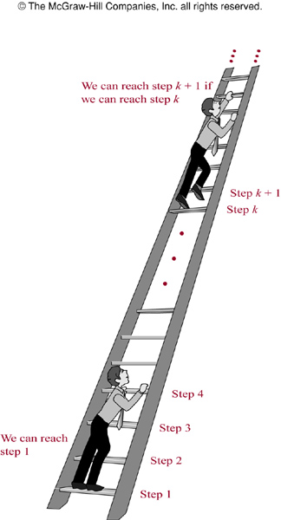
Mathematical induction
Remark.
  We want to know whether we can reach every step of this ladder
    We can reach the first rung of the ladder
    If we can reach a particular rung of the ladder, then we can reach the next rung

Slide 7
Mathematical induction
Mathematical induction
  Show that p(n) is true for every positive integer n
  Two steps in a mathematical induction
    Basis step: show that p(1) is true
    Inductive step: show that for all positive integers k, if p(k) is true, then p(k+1) is true. That is, we show p(k)→p(k+1) for all positive integers k
  The assumption “p(k) is true” is called the inductive hypothesis
  Proof technique:
  (p(1)∧∀k(p(k)→p(k+1)))→∀np(n)

Slide 8
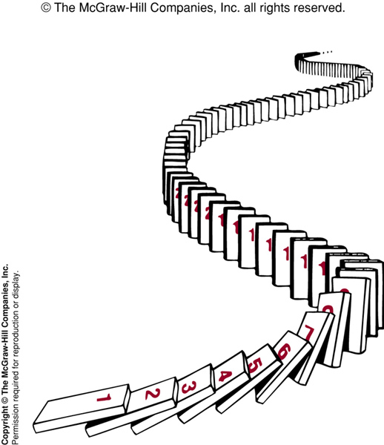
Analogy
  How Mathematical Induction Works Using Dominoes.

Slide 9
Writing a Proof by Induction
Example.
  Show that 1+2+… +n=n(n+1)/2, if n is a positive integer
  Proof.
  Let p(n) be the proposition that 1+2+… +n = n(n+1)/2
  Basis step: p(1) is true, because 1 = 1*(1+1)/2
  Inductive step:
  Assume p(k) is true for an arbitrary k. That is, 1+2+…+k = k(k+1)/2
  We must show that 1+2+…+k+(k+1) = (k+1)(k+2)/2
  From p(k), 1+2+…+k+(k+1) = k(k+1)/2+(k+1) = (k+1)(k+2)/2
  which means p(k+1) is true
  We have completed the basic and inductive steps, so by mathematical induction we know that p(n) is true for all positive integers n. That is 1+2+…+n = n(n+1)/2

Slide 10
Writing a Proof by Induction
Example.
  Conjecture a formula for the sum of the first n positive odd integers. Then prove the conjecture using mathematical induction
  Solution.
  1=1, 1+3=4, 1+3+5=9, 1+3+5+7=16, 1+3+5+7+9=25 …
  It is reasonable to conjecture the sum of first n odd integers is n², that is, 1+3+5+…+(2n-1)=n²
  Let p(n) denote the proposition
  Basic step:
  p(1)=1²=1
  Inductive steps:
  Assume that p(k) is true, i.e., 1+3+5+…+(2k-1)=k²
  We must show 1+3+5+…+(2k+1)=(k+1)² is true for p(k+1)

Slide 11
Writing a Proof by Induction
  Thus,1+3+5+…+(2k-1)+(2k+1)=k² +2k+1=(k+1)²
  which means p(k+1) is true
  (Note p(k+1) means 1+3+5+…+(2k+1)=(k+1)²)
  We have completed both the basis and inductive steps. That is, we have shown p(1) is true and p(k)→p(k+1)
  Consequently, p(n) is true for all positive integers n

Slide 12
Writing a Proof by Induction
Example.
  Use mathematical induction to show that 1+2+2²+…+2^{n} = 2^{n+1}-1
  Proof.
  Let p(n) be the proposition: 1+2+2²+…+2^{n}=2^{n+1}-1
  Basis step:
  p(0)=2⁰⁺¹-1=1
  Inductive step:
  Assume p(k) is true, i.e., 1+2+2²+…+2^{k}=2^{k+1}-1. It follows
  (1+2+2²+…+2^{k})+2^{k+1}=(2^{k+1}-1)+2^{k+1}=2*2^{k+1}-1=2^{k+2}-1 which means p(k+1): 1+2+2²+…+2^{k+1}=2^{k+2}-1 is true
  We have completed both the basis and inductive steps. By induction, we show that 1+2+2²+…+2^{n}=2^{n+1}-1

Slide 13
Writing a Proof by Induction
Remark.
  In the previous step, p(0) is the basis step as the theorem is true for all non-negative integers (∀np(n))
  To use mathematical induction to show that p(n) is true for n=b, b+1, b+2, … where b is an integer other than 1, we show that p(b) is true, and then p(k)→p(k+1) for k=b, b+1, b+2, …
  Note that b can be negative, zero, or positive

Slide 14
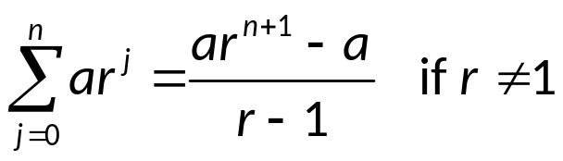
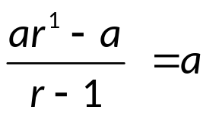
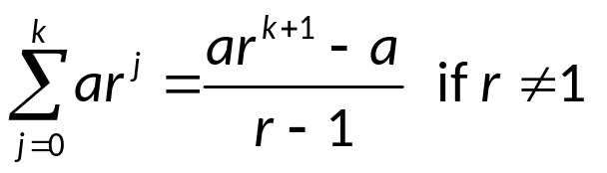
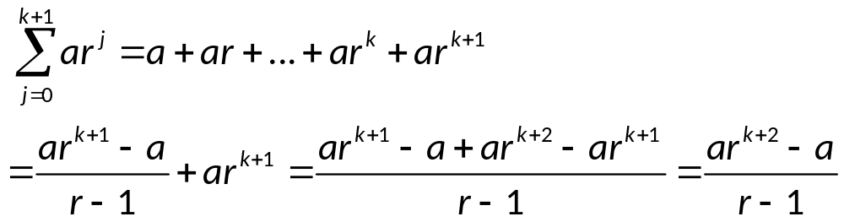
Writing a Proof by Induction
Example.
  Use mathematical induction to show
  Proof.
  Basis step:
  p(0) is true as
  Inductive step:
  Assume
  Then
  So p(k+1) is true. By induction, p(n) is true for all nonnegative integers

Slide 15
Writing a Proof by Induction
Example.
  Use mathematical induction to show that n<2^{n} for n>0
  Proof.
  Basis step:
  p(1) is true as 1<2¹=2
  Inductive step:
  Assume p(k) is true, i.e., k<2^{k}
  We need to show k+1<2^{k+1}
  k+1<2^{k}+1≤2^{k}+2^{k}=2^{k+1}
  Thus p(k+1) is true
  We complete both basis and inductive steps, and show that p(n) is true for all positive integers n

Slide 16
Writing a Proof by Induction
Example.
  Use mathematical induction to show that 2^{n}<n! for n ≥ 4
  Proof.
  Let p(n) be the proposition, 2^{n}<n! for n ≥ 4
  Basis step:
  p(4) is true as 2⁴=16<4!=24
  Inductive step:
  Assume p(k) is true, i.e., 2^{k}<k! for k ≥ 4. We need to show that 2^{k+1}<(k+1)! for k ≥ 4
  2^{k+1} = 2×2^{k} < 2×k!
  < (k+1)×k! = (k+1)!
  This shows p(k+1) is true when p(k) is true
  We have completed basis and inductive steps. By induction, we show that p(n) is true for n ≥ 4

Slide 17
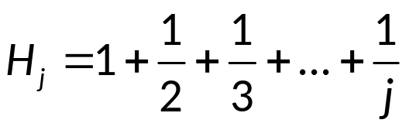
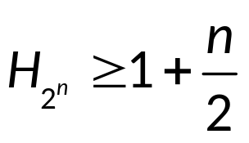
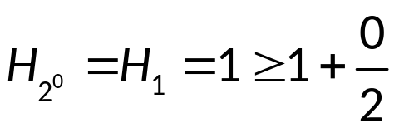
Writing a Proof by Induction
Example.
  The harmonic number (调和数) H_{j}, j∈{1, 2, 3, …} are defined by
  Use induction to show that for any nonnegative integer n
  Proof.
  Let p(n) be the proposition
  Basis step:
  p(0) is true as

Slide 18
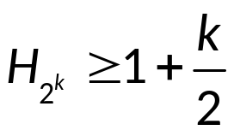
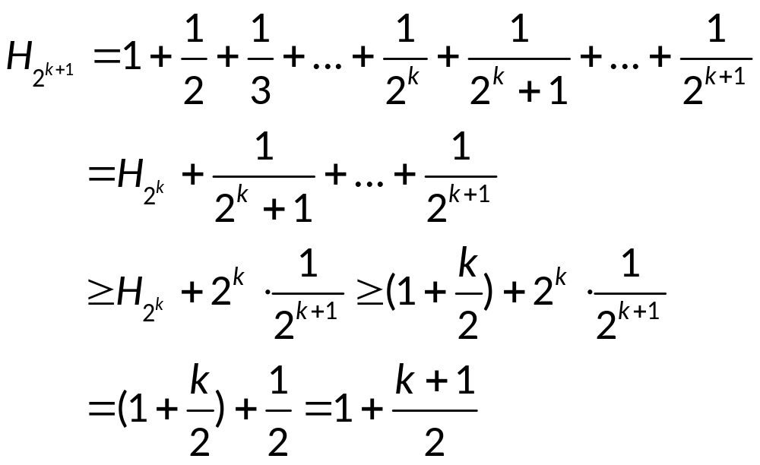
Writing a Proof by Induction
  Proof (continued).
  Inductive step:
  Assume p(k) is true for an integer k, k≥0. i.e.,
  We show that
  By induction, p(n) is true for k ≥ 0.

Slide 19
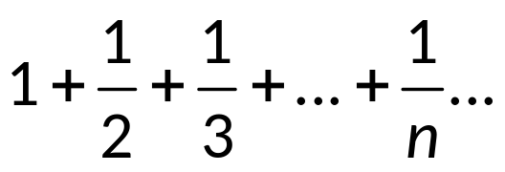
Writing a Proof by Induction
  Note: The inequality shows that the harmonic series
  is a divergent infinite series (不收敛无穷级数)

Slide 20
Writing a Proof by Induction
Example.
  Show that n³-n is divisible by 3 when n is positive
  Proof.
  Basis step:
  p(1) is true as 1³-1=0 is divisible by 3
  Inductive step:
  Assume that k³-k is is divisible by 3, we need to show that (k+1)³-(k+1) is divisible by 3
  (k+1)³-(k+1)=k³+3k²+3k+1-(k+1)=(k³-k)+3(k²+k)
  As both terms are divisible by 3, (k+1)³-(k+1) is divisible by 3
  We have completed both the basis and inductive steps. By induction, we show that n³-n is divisible by 3 when n is positive

Slide 21
Writing a Proof by Induction
Example.
  Show that if S is a finite set with n elements, then S has 2^{n} subsets
  Proof.
  Let p(n) be the proposition that a set with n elements has 2^{n} subsets
  Basis step:
  p(0) is true as a set with zero elements, the empty set, has exactly 1 subset
  Inductive step:
  Assume p(k) is true, i.e., S has 2^{k} subsets if |S|=k. Let T be a set with k+1 elements. So, T=S∪{a}, and |S|=k
  For each subset X of S, there are exactly two subsets of T, i.e., X and X∪{a}

Slide 22
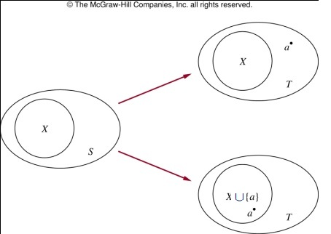
Writing a Proof by Induction
  Proof (continued).
  Because there are 2^{k} subsets of S, there are 2⋅2^{k}=2^{k+1} subsets of T. This finishes the inductive step.

Slide 23
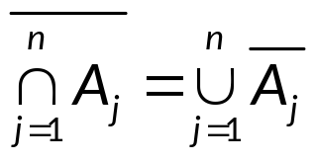
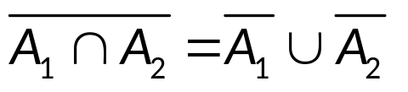
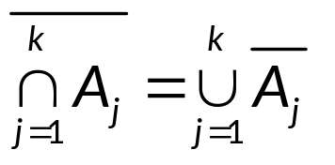
Writing a Proof by Induction
Example.
  Use mathematical induction to show one of the De Morgan’s law:
  where A₁, A₂, …, A_{n} are subsets of a universal set U, and n≥2
  Proof.
  Basis step:
  Inductive step: Assume
  is true for k ≥ 2

Slide 24
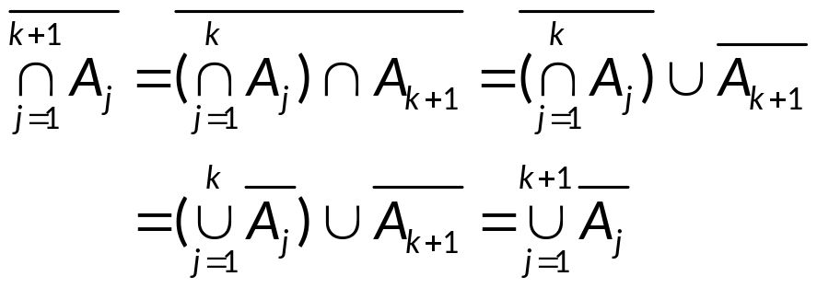
Writing a Proof by Induction
  Proof (continued).
  Then:
  This finishes the inductive step.

Slide 25
Writing a Proof by Induction
Example. (Deficient Tiling)
  A 2^{n} x 2^{n} sized grid is deficient if all but one cell is tiled.
2^{n}
2^{n}

Slide 26
Writing a Proof by Induction
Example. (Deficient Tiling)
  Show that any 2^{n} x 2^{n} sized deficient grids can be tiled with right triominoes (三格板), which are pieces that cover three squares at a time, like this:

Slide 27
Writing a Proof by Induction
  Proof.
  Base case:
  It is true for 2¹ x 2¹ sized deficient grids
  Inductive Step:
  Assume that we can tile a 2^{k} x 2^{k} deficient board using our designer tiles. Use this to prove that we can tile a 2^{k+1} x 2^{k+1} deficient board using our designer tiles.

Slide 28
Writing a Proof by Induction
  Proof (continued).
  Consider a 2^{k+1} x 2^{k+1} sized checkerboard with one square removed. Split this checkerboard into four checkerboard of size 2^{k} x 2^{k}. Without loss of generality, No square has been moved from the up-left, up-right and down-left parts

Slide 29
Writing a Proof by Induction
  Proof (continued).
  Remove one square from each of the 3 parts, as shown in RED below. All the four checkerboard are 2^{k} x 2^{k} deficient. By induction hypothesis, they all can be titled with right triominoes.
  The left RED colored space can be tiled by a right triominoe. Now we have the 2^{k+1} x 2^{k+1} deficient board tiled.

Slide 30
Axioms for the set of positive integers
Axioms for the set of positive integers
  Axiom 1:
    The number 1 is a positive integer
  Axiom 2:
    If n is a positive integer, then n+1, the successor of n, is also a positive integer
  Axiom 3:
    Every positive integer other than 1 is the successor of a positive integer
  Axiom 4:
    Every non-empty subset of the set of positive integers has a least element (Well-ordering property)
Refer to the Peano axioms

Slide 31
Why mathematical induction is valid?
Why is mathematical induction a valid proof technique?
  From mathematical induction, we know p(1) is true and the proposition p(k)→p(k+1) is true for all positive integers
  To show that p(n) must be true for all positive integers, assume that there is at least one positive integer such that p(n) is false
  Then the set S of positive integers for which p(n) is false is non-empty
  By well-ordering property, S has a least element, which is denoted by m
  We know that m cannot be 1 as p(1) is true

Slide 32
Why mathematical induction is valid?
  Because m is positive and greater than 1, m-1 is a positive integer
  Because m-1 is less than m, it is not in S
  So p(m-1) must be true
  As the conditional statement p(m-1)→p(m) is also true, it must be the case that p(m) is true
  This contradicts the choice of m
  Thus, p(n) must be true for every positive integer n

Slide 33
Assignment
Exercises after 4.1: No.25, 53, 54, 70 (b) (Ver.6)
Exercises after 5.1: No.25, 57, 58, 74(b) (Ver.7)

